Slide 1


NO SQL Programming
Project Brief
Submit Campus: 15 November 2024, by 10 am

Slide 2
Main Objective
Understand the key concepts, elements and dimensions of NOSQL corresponding to MONGODB
Learn and understand the use of MongoAtlas, Mongo Compass and Mongo Shell, by connecting them for querying cloud-based clusters.
Demonstrate literacy in NOSQL query-based programming from cloud-based database [using Mongo Atlas and Compass]
Demonstrate literacy in NOSQL indexing and aggregation programming methods [using Mongo Atlas and Compass]

Slide 3
Context
You have applied for a Data Analyst position in an organization. As a part of the recruitment process, the organization has asked you to work in a team OR individually.
As a team OR Individually,
Create a database and include your own collection [upload a CSV or JSON file]
You can search JSON or CSV datasets over internet [Be careful with the size of the file, due to space constraints] [Choose a file which has arrays/objects]
The aim is to develop NO SQL queries and charts for the selected collection, to derive meaningful insights from the data demonstrating your knowledge, technical and data-centric decision-making skills, critical thinking and ability to use Mongo DB
You will demo which will be followed by usual question-answers session

Slide 4
Minimum Requirements [if working individually]
For each selected collection
Develop minimum 08 Queries (meaningful, non-trivial and useful) and 2 Charts
At least 2 of these queries should be Aggregation [requiring grouping/unwind]
At least 2 queries – using a mix of comparison and logical operators
At least 2 queries – using $expr
At least 2 queries – based on arrays, sub documents and similar
Develop minimum 2 Charts using Mongo Atlas. You need to use query in the charts as well.
For each query state the objective and briefly the business value in the document
You can use notion.so to save you queries in the format given here https://tinyurl.com/4c26kz46
Create a free account in notion.so
Then open this link: https://tinyurl.com/4c26kz46
Go to top right of the screen once you have opened the above link and select Duplicate
A duplicate of the document will be available in your own notion account
If you are more comfortable with notepad you can use it.
Submission: in Campus [submit a document with names of all team members and notion link OR Notepad]

Slide 5
Minimum Requirements [if working in Teams]
For each selected collection
Develop minimum 16 Queries (meaningful, non-trivial and useful) + 5 charts
At least 4 of these queries should be Aggregation [requiring grouping/unwind]
At least 6 queries – using a mix of comparison and logical operators
At least 2 queries – using $expr
At least 4 queries – based on arrays, sub documents and similar
Develop minimum 5 Charts using Mongo Atlas. You need to use query in the charts as well.
For each query state the objective and briefly the business value in the document
You can use notion.so to save you queries in the format given here https://tinyurl.com/4c26kz46
Create a free account in notion.so
Then open this link: https://tinyurl.com/4c26kz46
Go to top right of the screen once you have opened the above link and select Duplicate
A duplicate of the document will be available in your own notion account
If you are more comfortable with notepad you can use it.
Submission: in Campus [submit a document with names of all team members and notion link OR Notepad]

Slide 6
Demo will be followed by Q and A
Practice Questions (Example)
What is the difference between SQL and No SQL
What is a JSON File?
What are the development tools in MongoDB
Explain each tool [why it used]
Why do we use $expr
What is the difference between $and and $not
What is the difference between collection and document
What is an array
What is an object array
What is projection
How do we use projection, give an example
What is $elemMatch
What is aggregation, give an example
When do we use project in aggregation?

Slide 7
Demo will be followed by Q and A
Practice Questions (Example)
Is this a correct expression ({"genres": {"$size": {{“$gt”}:2},"$all":["Drama", "Comedy"]}}
Is this a correct expression ({ "$expr": { "$eq": [ "end station id", "start station id"]
What are the uses of $ symbol
Is this a correct expression
{ "$or" :[ { “$airplane": "CR2" }, { “$airplane": "A81" } ] }

Slide 8
Grading Criteria
Grading Dimension | Marks Allocated
Quality and importance of queries, i.e., ability to form meaningful and purposeful queries from a given dataset (for e.g., using operators in selected queries including and beyond the ones taught in the session, further extending knowledge) | 20
Queries are non-trivial (i.e., complex and demonstrating advance knowledge). ability to form meaningful and purposeful queries from a given dataset that will help in formulating recommendations) | 20
Quality and insights provided by charts, i.e., ability to design interesting and insightful charts from a given dataset (for e.g., including and beyond the ones taught in the session, further extending knowledge) | 20
Ability to answer questions [as a pair and individually, and based on the work done in the project], demonstrating knowledge of the NO-SQLconcepts and MongoDb queries and components | 30
Execution all queries run without any errors, and suitably documented in the text file in the prescribed format | 10
Notes:
8

Slide 9
Help and Advise [Open Door Policy with a bit of Notice]
If you face any issues/problems/challenges
PLEASE contact me
PM me on SLACK to arrange a meeting.
I will help either F2F or virtually
You must seek help if and when you need. This is extremely important. I want you to learn but at the same time help overcome challenges when you are stuck/unsure
DO NOT HESITATE: I AM grading your work, but at the same time its my duty to help you learn and apply ☺
NOTE: Some problems may take time to solve, depending on the complexity and nature ☺
Notes:
9

Slide 10
Formative Feedback
Show your work before demo to get feedback
Perhaps improve some things [understand if queries are fine/ non-trivial]
Book one or more timeslots 30 mins with me for formative feedback, as and when you need
One that works for both your team members
This is your chance to get useful advice to improve the work
I will provide feedback strictly based on the grading criteria
NOTE: Please book In Advance (I may be engaged in teaching or other professional activities)☺
Notes:
10

Slide 11
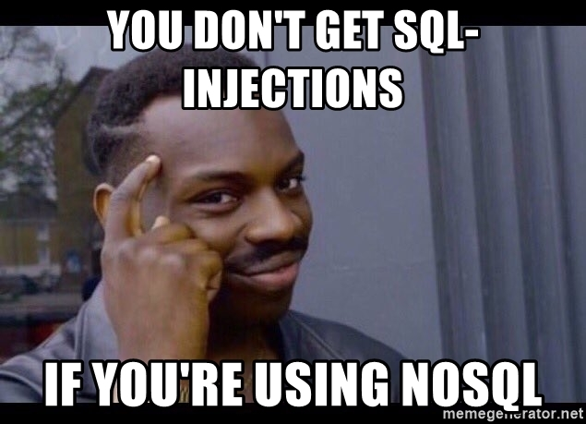


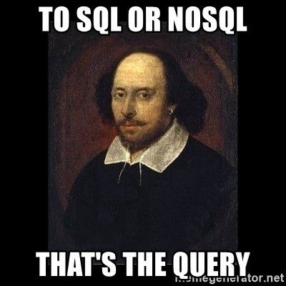
Notes:
11

